Slide 1
Data Science Term Project
201433264 박성원
201735877 정은서
201835434 김주현

Slide 2
CONTENTS
01
02
03
04
Introduction
Data processing
Role
Schedule

Slide 3
01
Introduction

Slide 4
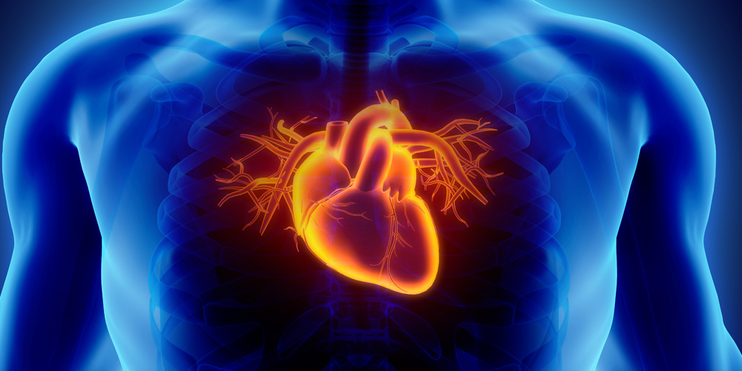
01.
Introduction
1–1. Objective
The heart is one of the most important organs in our body.
It is important to check heart's health and predict disease in advance.
Image source : http://koreahim.co.kr/ultrasonic/ultrasonic07.html

Slide 5
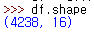
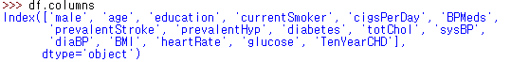
01.
Introduction
1–2. Data Information
▶ Data Shape
-> Data Set has 4,238 row and 16 columns.
▶ Data Category

Slide 6
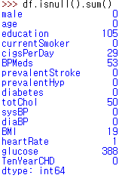
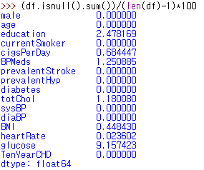
01.
Introduction
1–2. Data Information
▶ Total Missing Value
▶ Missing Value
Ratio
(unit : %)

Slide 7
01.
Introduction
1–2. Data Information
▶ Detail Information of Columns
#male - Male or female
#age - Age of the patient
#education - No definition found for education.
#currentSmoker - Whether the patient is a current smoker
#cigsPerDay - The number of cigarettes that the person smoked on average in one day
#BPMeds - Whether the patient was on blood pressure medication
#prevalentStroke - Whether the patient had previously had a stroke
#prevalentHyp - Whether the patient was hypertensive
#diabetes - Whether the patient had diabetes
#totChol - Total cholesterol level
#sysBP - Systolic blood pressure
#diaBP - Diastolic blood pressure
#BMI - Body Mass Index
#heartRate - Heart rate
#glucose - Glucose levels
#TenYearCHD - Predict variable(1 = Yes; 0 = No)

Slide 8
02
Data Processing

Slide 9
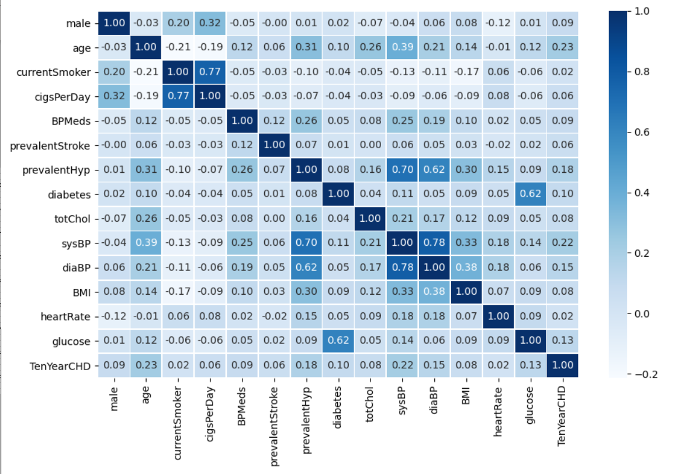
02.
Data Processing
2-1. Data Preprocessing
▶ Dirty data processing
▷▶ NaN data processing
→ Calculate attributes’ covariance
→ Collect other data which has the same value in highly relevant attributes
→ Obtain the average of the data or most data to fill the NaN data
▷▶ Drop ambiguous NaN data

Slide 10
02.
Data Processing
2-2. Data Analysis
▶ Target Value : Heart disease diagnosis
▶ Analysis Algorithm : KNN Algorithm(K-Nearest Neighbor Algorithm)
▷▶ Scaling data
→ Min-Max scaler / Standard scaler / Robust scaler => find best scaler by comparing accuracy
▷▶ Set K value
→ If K = 3 / K = 5 / K = 7 …
▷▶ Divide data(train dataset / test dataset)
▷▶ Predict target value by trained model and check accuracy of model

Slide 11
02.
Data Processing
2-2. Data Analysis
▶ Target Value : Heart disease diagnosis
▶ Analysis Algorithm : Logistic Regression
What is ‘Logistic Regression’?
▷▶ Use regression to predict the probability that the data fall into a category from 0 to 1 and classify it as belonging to a higher probability category based on that probability

Slide 12
02.
Data Processing
2-2. Data Analysis
▶ Target Value : Heart disease diagnosis
▶ Analysis Algorithm : Logistic Regression
Progress
▷▶ Scaling data
→ Min-Max scaler / Standard scaler / Robust scaler => find best scaler by comparing accuracy
▷▶ Create Logistic Regression model
▷▶ Separating features which we need when analysis data
▷▶ Divide data(train dataset / test dataset)
▷▶ Predict target value by trained model and check accuracy of model

Slide 13
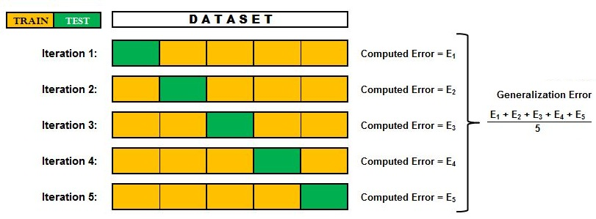
02.
Data Processing
2-3. Evaluation
▶ K-Fold Cross-Validation
▷▶ Find and set the appropriate K
▷▶ Divide the whole data into K equal parts
▷▶ Only one of them is used as a test set
▷▶ Repeated k times

Slide 14
03
Role

Slide 15



03.
Role
201433264
Seongwon Park
201735877
Eunseo Jeong
201835434
Joohyun Kim
Cleaning data, Data Preprocessing, Analysis, Evaluation

Slide 16
04
Schedule

Slide 17
04.
Schedule
SUN | MON | TUE | WED | THR | FRI | SAT
 | 1 | 2 | 3 | 4 | 5 | 6
7 | 8 | 9 | 10 | 11 | 12 | 13
14 | 15 | 16 | 17 | 18 | 19 | 20
21 | 22 | 23 | 24 | 25 | 26 | 27
28 | 29 | 30 | 1 | 2 | 3 | 4
Cleaning data
Data preprocessing
Data processing
Data analysis
Data analysis
Data evaluation
PPT
FINAL
presentation
PPT

Slide 18
Thank you

